Slide 1
INT -217 PRESENTATION - a project on STATISTICAL ANALYSIS OF GOOGLE PLAY STORE
Name : Peddapuram shiva kumar
reg.no :11811598
Section : KM074

Slide 2
context
introduction ;
Objectives/Scope of the Analysis ;
Source of dataset ;
ETL process ;
Objectives and explanations ;
Analysis on dataset ;
visualization and analysis of objective ;
List of Analysis with results ;
Reference/Bibliography ;

Slide 3
Introduction :
In these project I have done a statistical analysis on playstore
I have used the following terminologies here are the explanation about them
App name : The name of the app (title of the application)
Category :- Category to which the app belongs (art ,music, dating, sports etc.)
Rating :- Rating value of the app (Ratings are numbered values given by the users after their experience or usage Ratings are numbered values from 1-5 in stars format)
Reviews :-Review count The number of reviews provided by the users after their mind-blowing performance and experience
Installs :- Number of verified installs (in this option it contains the number of verified customers installed this app and used it for a while)
Size :- Size of the app (coming to the point of size it is the memory space that is been consumed by the mobile phone while installing a particular app and the way It consumes the storage or memory in the disk or mobile storage)
Price :- Price of the app in $ dollars(coming to the point of pricing some apps can be downloaded freely and some are paid . the pricing list is totally dependent on the developers end)

Slide 4
(8.) Content Rating :- Intended audience or age group targeted
(9.) Last Updated :- Last Updated date (after bug fixing or fixing any issue and resolving it they will update those app
(10.) Minimum Version :- Minimum Android version required to run the app (particular android version required to run a particular aaplication . as some of the applications does not support the older versions due to issues like android level support )
(11.) Latest Version :- Current version of the app

Slide 5
Objectives/Scope of the Analysis :-
Analyzing the good app based on the following 6 objectives
Calculating the top 10 number ratings for a particular app from play store dataset
Calculating the Top ranking of applications based on content wise
Calculating top 10 Application based on Installs.
Number of apps that are most recently updated
top maximum sized app category wise
Calculating the average no of ratings for a particular app from play store dataset
Calculating the average one-off categories rank for a particular application
The main scope point is to find the most suitable application for a particular category for people based on the given rating review

Slide 6
Source of dataset :
I had Collected all resources for my project from Kaggle and data.gov.in
KAGGLE :- KAGGLE is an online community of data scientists and machine learners, owned by Google. Kaggle allows users to find and publish data sets, explore and build models in a web-based data-science environment, work with other data scientists and machine learning engineers, and enter competitions to solve data science challenges. Kaggle got its start by offering machine learning competitions and now also offers a public data platform, a cloud-based workbench for data science, and short-form AI education. On 8 March 2017, Google announced that it was acquiring Kaggle.
Open Government Data (OGD) :- Open Government Data (OGD) Platform India - data.gov.in - is a platform for supporting the Open Data initiative of the Government of India. The portal is intended to be used by the Government of India Ministries/ Departments their organizations to publish datasets, documents, services, tools and applications collected by them for public use. It intends to increase transparency in the functioning of Government and also open avenues for many more innovative uses of Government Data to give
Kaggle Link:-https://www.kaggle.com/mrwolfgang/google-playstore-eda

Slide 7
ETL process:
ETL stands for “extract, transform, and load.”
ETL is defined as a process that extracts the data from different RDBMS source systems, then transforms the data (like applying calculations, concatenations, etc.) and finally loads the data into the Data Warehouse system. ETL full-form is Extract, Transform and Load.
Data Extraction:- In this step, I had removed all the duplicated values, false values, etc…
Data Transformation:- In this step, I had replaced null values with NAN and transformed percentage values to numerical values, calculated some row values which were not given using Tableau.
Data Load:- In this step, I had transformed data according to my project and I had calculated the required data and created pivot tables after data load.
The process of ETL plays a key role in data integration strategies. ETL allows businesses to gather data from multiple sources and consolidate it into a single, centralized location. ETL also makes it possible for different types of data to work together.

Slide 8
Analysis and visualization :
Visualzation-1: Top 10 aaps based on category
This analysis helps in finding out the best application based on the reviews. Reviews describe the application features and the user views to that application. This pivot chart represents the top reviews of the applications based on the category.
Introduction:This objective is about finding best application based on the best application based on the reviews
General Description :As we use many applications in our day to day life many customers review the application after experience .this helps us a lot in analysing the best application.
Specific Requirements, functions and formulas: Coming to the point of specific requirements we need the requirement of reviews of lot of people which helps us a lot in analysing the data and analysing the best application.

Slide 9
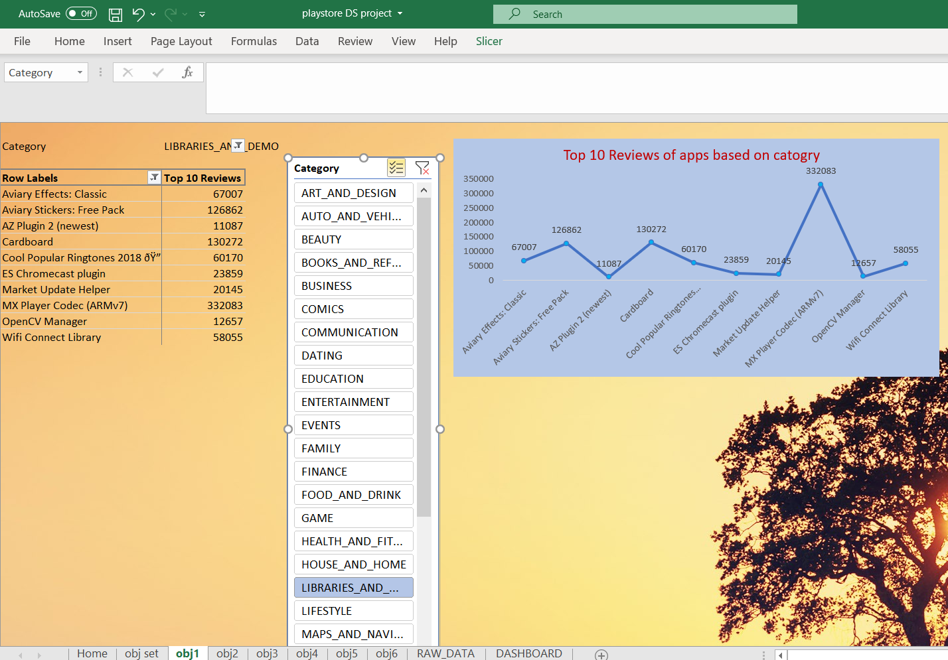
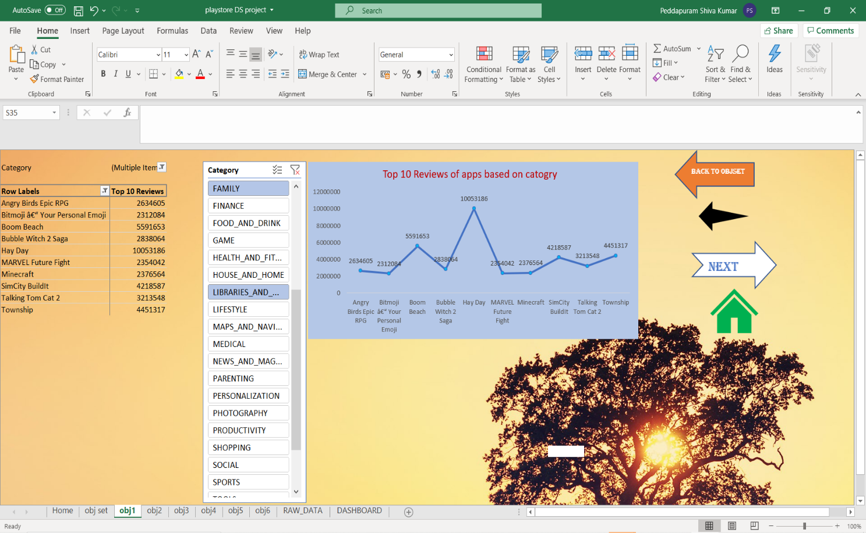
Visualization :

Slide 10
Visualization-2:- number of aap based on content rating
This analysis helps in finding the number of applications available based on the category of the type (free or paid) for the users based on their age.
Introduction:- This objective is about the number of applications available based on the category of the type Whether paid or for free based on their age group
General Description :- Many of the users shows interest for free services but when we go through the following visualization, we get an overall view about the type of users
Specific Requirements, functions and formulas :- Coming to the point of specific requirements functions and formula the main specific requirement I have used here the type of category for a particular application whether it is paid or for freely available in play store. and second most important thing I have compared is the age group the customers or audience specifically belongs to
Analysis results This pivot chart represents number of applications based on the content rating.

Slide 11
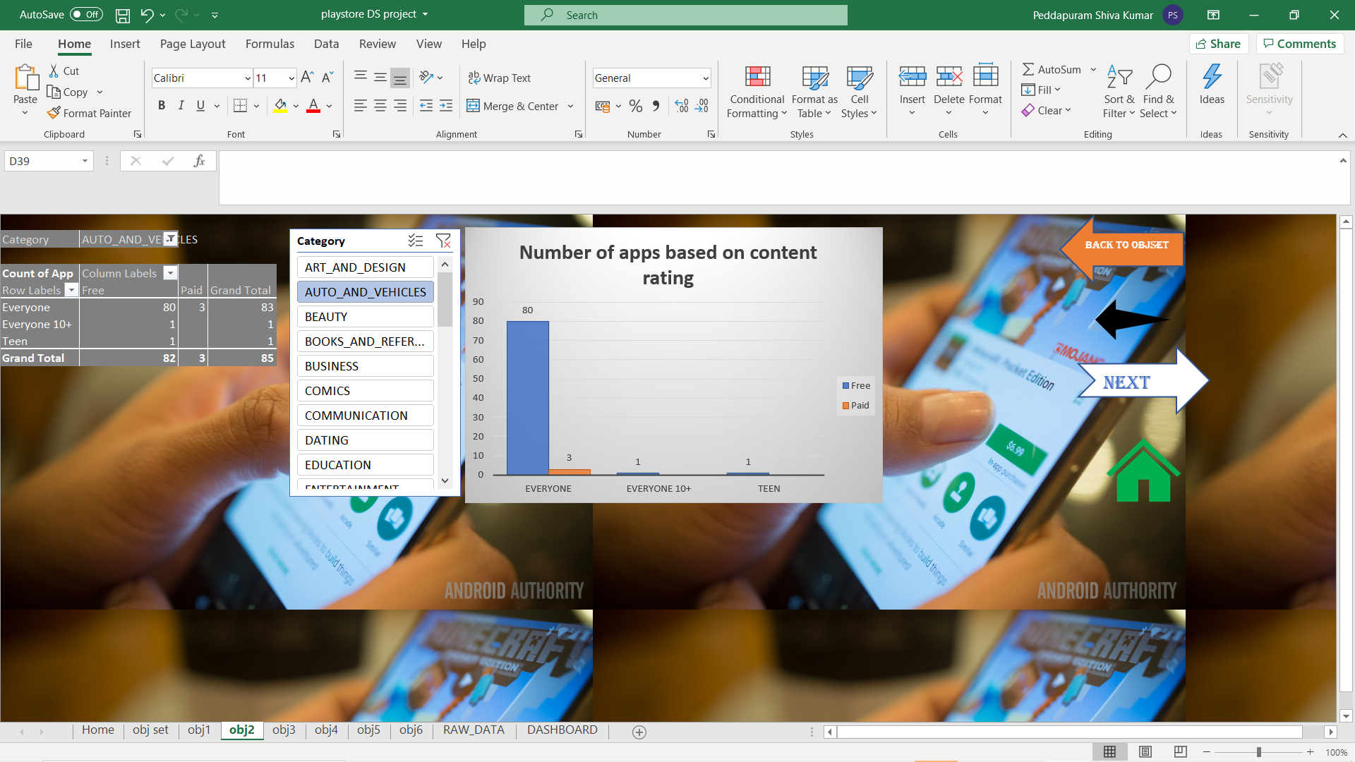


Slide 12
Visualization-3:- Top RANKING of apps based on INSTALLS
Introduction :- This objective is about “ Top RANKING of apps based on INSTALLS ”
General Description :- In these objective we can get the information about the ranking of top 10 aap based on installs.
Basically there are some kind of misinformation like users downloads apps and then just uninstall them
Specific Requirements, functions and formulas :Basically we deal about the top 10 installs for some websites based on their category and finalize the better ones as per the requirements

Slide 13
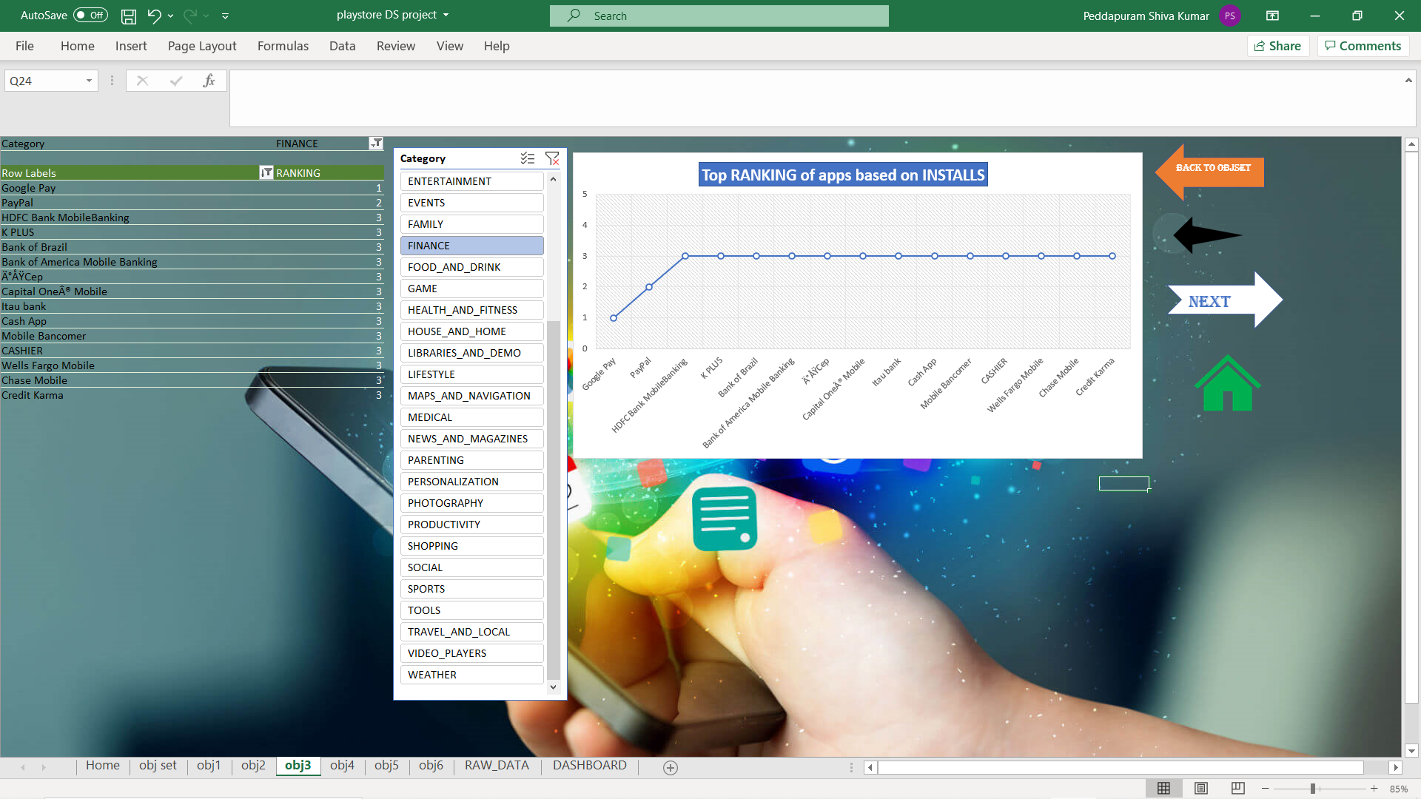
Visualization results :

Slide 14
Visualization-4:- number of apps based on rating
Introduction:- This objective is about the number of apps based on rating.
General Description :Rating is the main requirement for the application development and promotion and it helps lot of the customers.
Specific Requirements, functions and formulas
In this objective I have analysed the number of apps based on rating

Slide 15
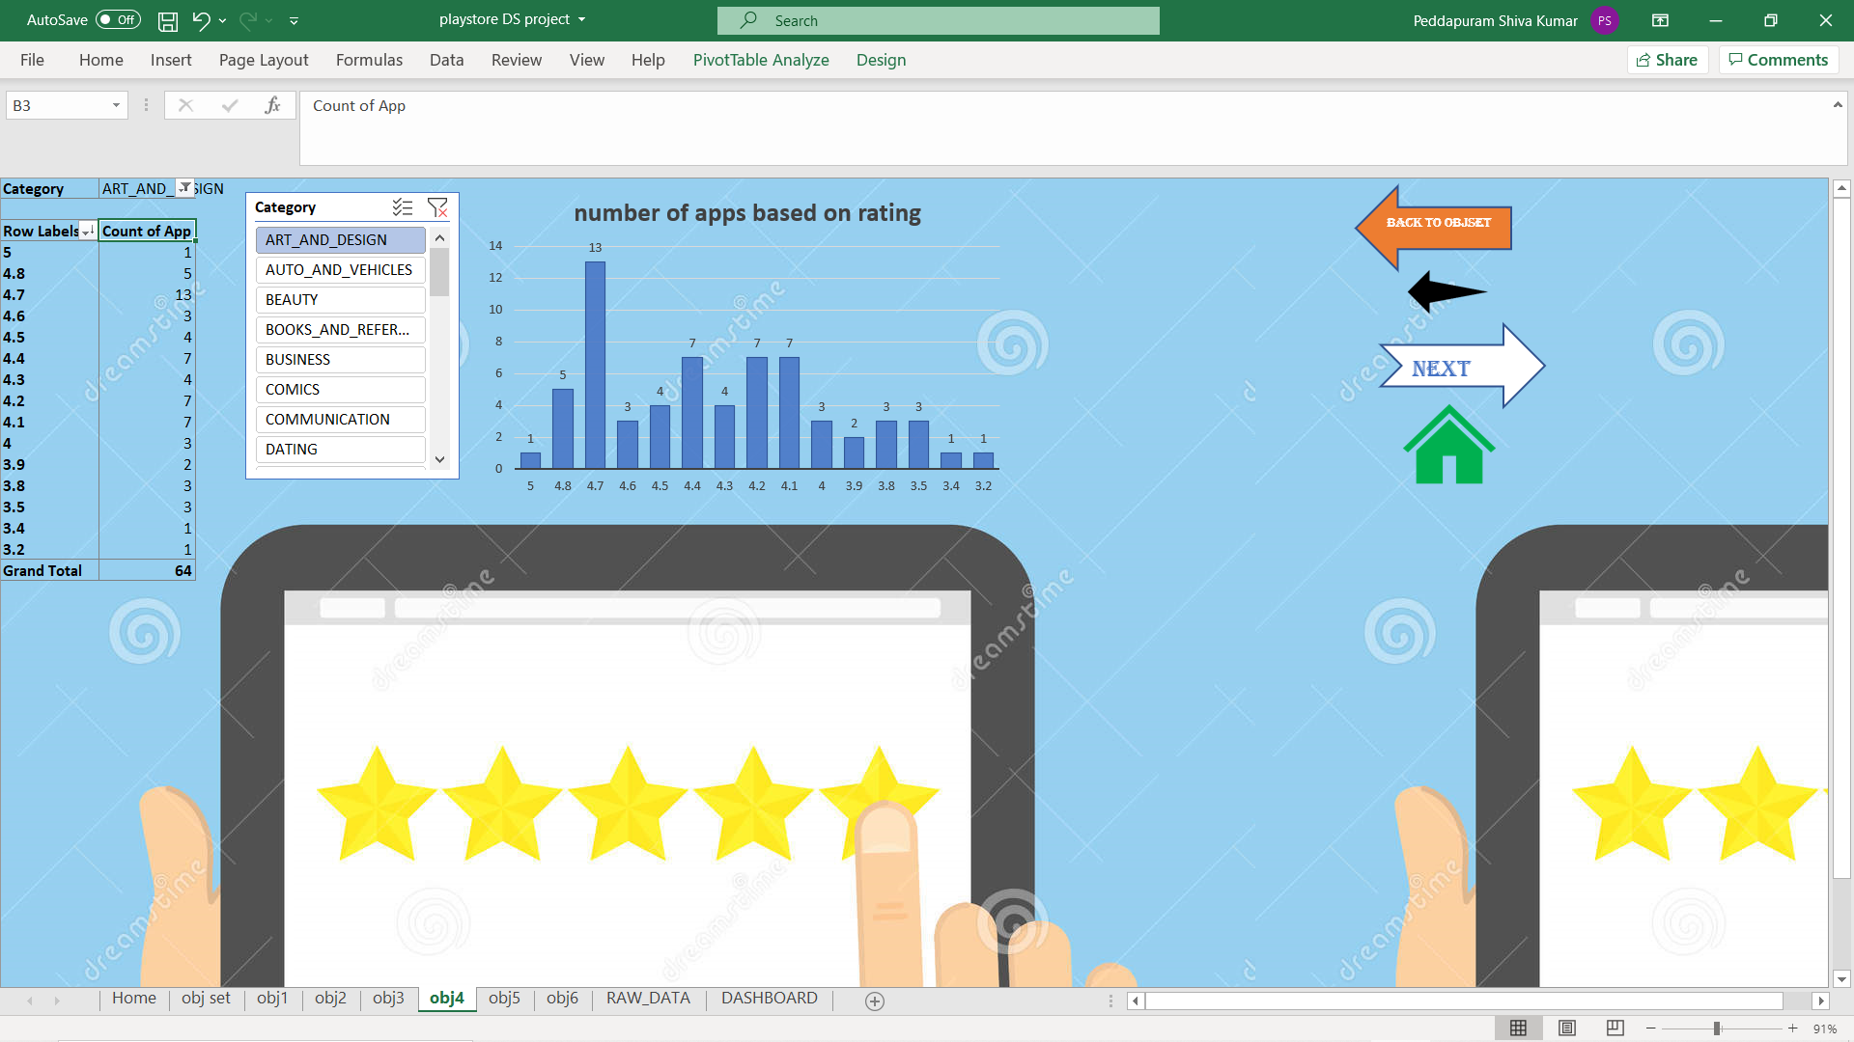
Analysis results

Slide 16
Visualization-5:-
Introduction:- This objective is about the Number of apps that are most recently updated
General Description :- As customers uses the application many of them gets many issues in order to resolve those issues lot of updates are done. As the application gets updated it gives lot of best experience to the customers. Which further helps the customers to feel happy and satisfied for the usage
Specific Requirements, functions and formulas :- In this objective I have analysed the number of apps that was recently updated.

Slide 17
Visualization-6:-
Introduction:- This objective is about the “top maximum sized app category wise “
General Description In these analysis I have analysed about the maximum size of the application as per category wise
As the size of the application increases many of the customers shows less interest to download it.
Specific Requirements, functions and formulas
In this objective I have analysed about the application which has maximum sized as per category wise.

Slide 18
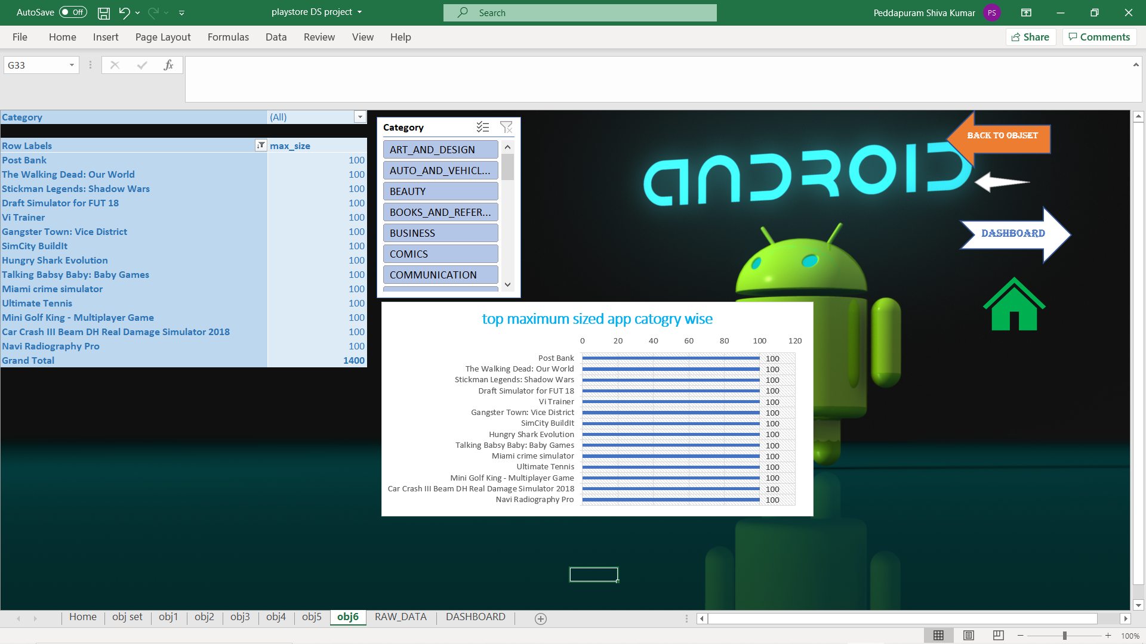
Analysis results :-

Slide 19
List of Analysis with results :
Analyzing the good app based on the following 6 objectives
Calculating the top 10 number ratings for a particular app from play store dataset
Calculating the Top ranking of applications based on content wise
Calculating top 10 Application based on Installs.
Number of apps that are most recently updated
top maximum sized app category wise
Calculating the average no of ratings for a particular app from play store dataset
Calculating the average one-off categories rank for a particular application
In the dashboard the combination of the above objectives is also provided to compare and with the slicers and timelines provided we can download the particular app as per our requirements

Slide 20
Reference/Bibliography :
https://www.kaggle.com/kracekumar/indian-elections
https://en.wikipedia.org/wiki/Elections_in_India ′
https://data.gov.in/search/site?query=elections ′
https://eci.gov.in/

Slide 21
Thank you all for watching my presentation and listening to the information keenly
Thanks a lot for listening

